Slide 1
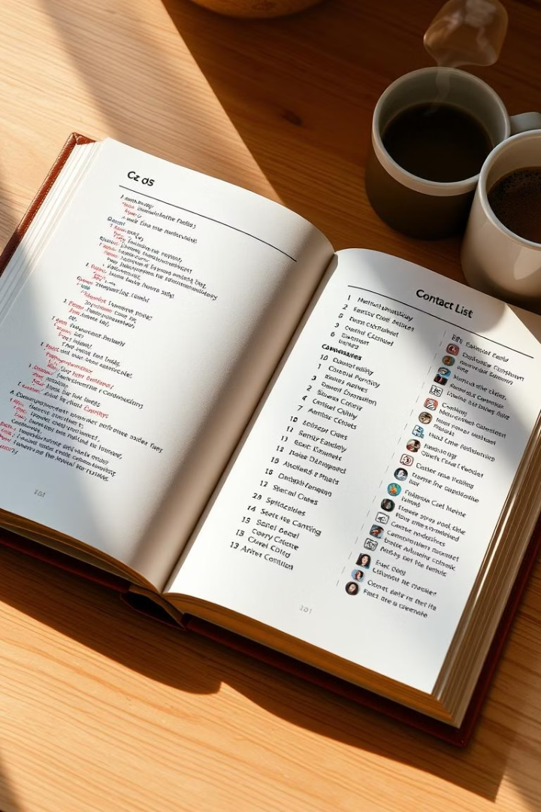
C File I/O and Data Structures: A Contact Management Example
Welcome! This presentation will guide you through practical applications of file I/O and data structures in C. We'll explore how to create, read, update, and delete data within a simple contact management program. By the end, you'll understand how to implement similar functionalities in your own projects, enhancing your C programming skills.

Slide 2
Defining the Contact Structure
The struct Contact Definition
Here's the code:
The foundation of our contact management system is the struct Contact. This structure groups related data items—name, phone, and email—into a single unit. This approach simplifies data handling and enhances code readability. It's a fundamental concept in C programming for organizing complex information.
struct Contact { char name[50]; char phone[15]; char email[50]; };

Slide 3
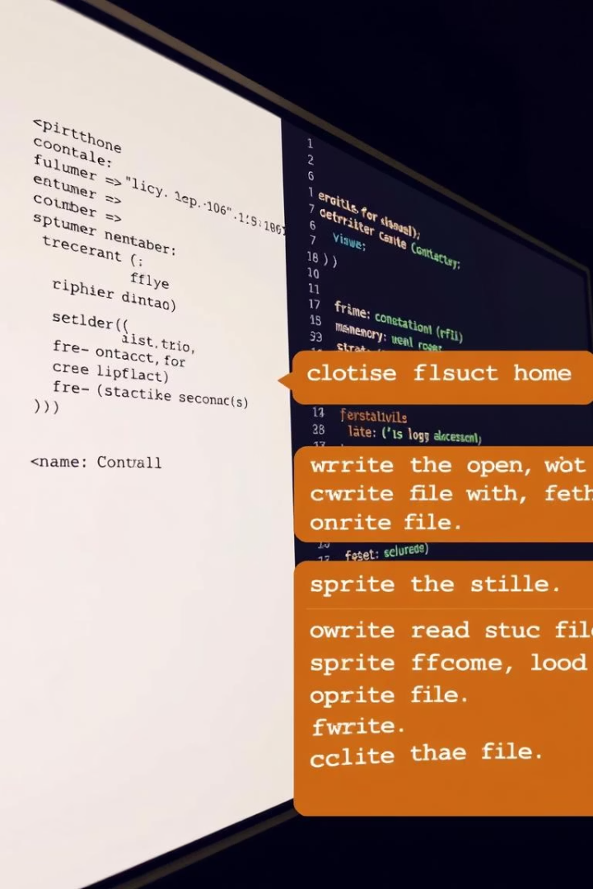


Adding New Contacts to the File
addContact() Function
File Writing
The addContact() function appends new contact records to the "contacts.dat" file. It prompts the user for contact details, then uses fwrite() to write the struct Contact data directly to the file. fseek() ensures data is appended to the end of the file, preserving existing records and maintaining data integrity.

Slide 4
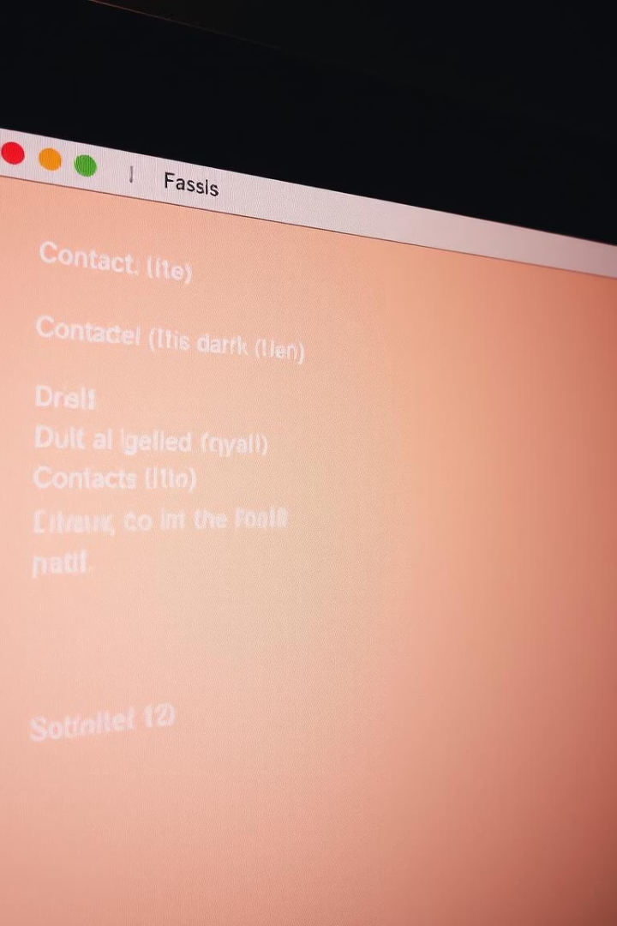



Viewing Existing Contacts
viewContacts() Function
Iterates through the file.
fread() Usage
Reads contact data sequentially.
Display Output
Prints formatted contact information.
The viewContacts() function retrieves and displays all contacts from the "contacts.dat" file. It uses fread() in a loop to read each struct Contact record, then prints the name, phone, and email fields to the console. rewind(fp) resets the file pointer to the beginning, ensuring all records are read from start to finish.

Slide 5



Searching for Specific Contacts
1
User Input
2
strcmp() Function
3
Display Result
The searchContact() function allows users to find a contact by name. It prompts for a search term, then iterates through the "contacts.dat" file, comparing the entered name with each contact's name field using strcmp(). If a match is found, the contact details are displayed; otherwise, a "Contact Not Found" message is shown. rewind(fp) ensures the search starts from the beginning of the file.

Slide 6
Deleting a Contact from the File
Temporary File
1
Creation of a temporary file.
Conditional Writing
2
Data is written if it doesn't match the name.
File Operations
3
Removing old file and renaming new one.
The deleteContact() function removes a contact from the "contacts.dat" file. It prompts the user for the name of the contact to delete, then creates a temporary file ("temp.dat"). It reads each contact from the original file, writing it to the temporary file unless the name matches the deletion target. The original file is then removed, and the temporary file is renamed to "contacts.dat".

Slide 7
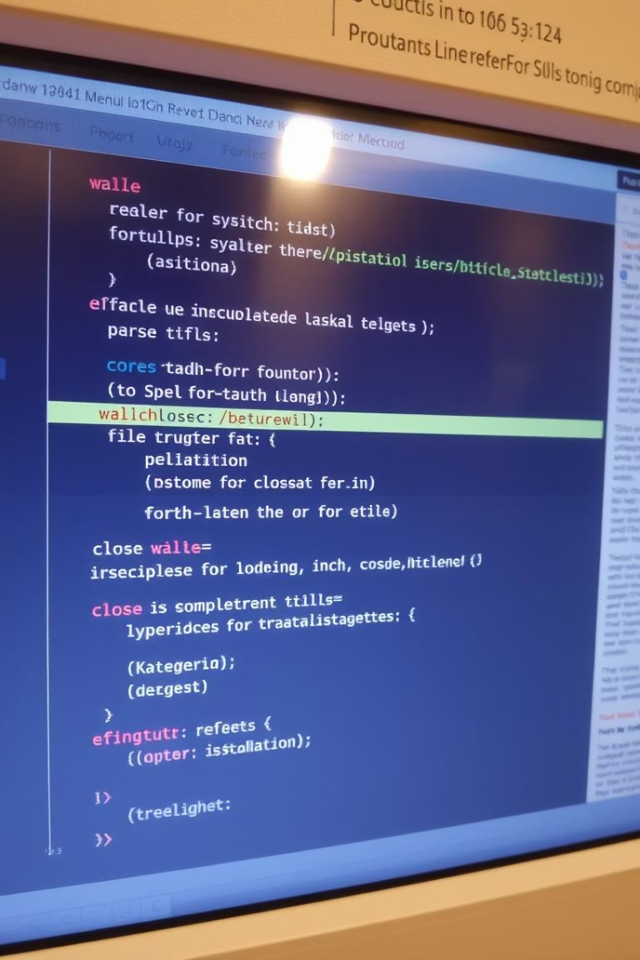
Main Function and Menu
1
File Handling
2
Menu Options
Opening and closing the file.
Choices for the user to interact.
3
Switch Statement
Handling different choices.
The main() function is the entry point of the program. It opens the "contacts.dat" file in read-write binary mode or creates it if it doesn't exist. It then presents a menu with options to add, view, search, or delete contacts. A switch statement handles user input, calling the appropriate function based on their choice. The program loops until the user chooses to exit, at which point the file is closed.

Slide 8



Error Handling Considerations
2
Memory Allocation
Avoid memory leaks.
File Open Errors
1
Check if file opens correctly.
Invalid Input
Handle bad user input gracefully.
3
Robust error handling is crucial for reliable C programs. Always check if file operations are successful, handle potential memory allocation failures, and validate user input to prevent crashes or unexpected behavior. Proper error messages can greatly aid debugging and improve the user experience. Consider adding checks for fopen() returning NULL and validating input with fgets() plus sscanf().

Slide 9
Improving the Code
Dynamic Memory
Sorting
User Interface
Use for name, phone, and email to avoid fixed-size buffers.
Implement sorting and search using algorithms.
Make it more appealing.
This contact management program can be enhanced in several ways. Consider using dynamic memory allocation to handle variable-length names, phone numbers, and email addresses. Implement sorting functionality and refine the search algorithm. Finally, improve the user interface with a more structured and visually appealing design, enhancing the overall user experience.

Slide 10
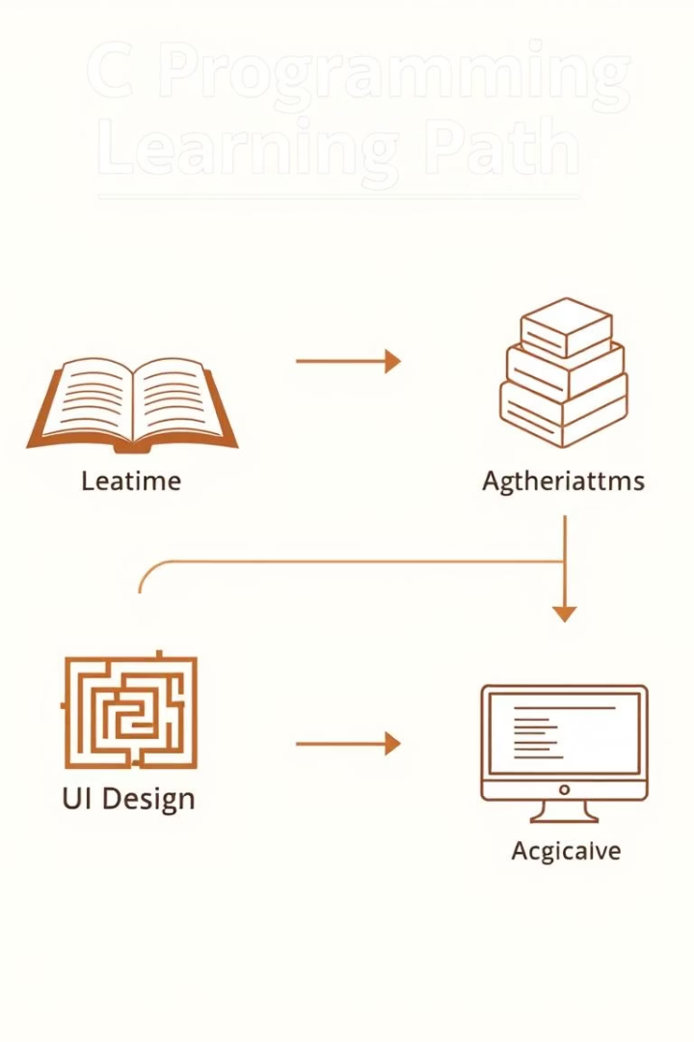
Key Takeaways and Next Steps
1
File I/O
Fundamental for data persistence.
2
Data Structures
Organize related data effectively.
You've learned how to use file I/O and data structures in C to manage contact information. Next steps include exploring more advanced data structures, implementing better search algorithms, and designing a user-friendly interface. These skills are essential for building robust and efficient applications. Experiment and build your own tools!

